Slide 1

THERMODYNAMICS I (ME 265)
SECOND LAW OF THERMODYNAMICS
Francis Kofi Forson (PhD)
Department of Mechanical Engineering
Kwame Nkrumah University of Science and Technology, Kumasi, Ghana

Slide 2

Second Law of Thermodynamics
A process will occur in a specified direction, not just in any direction:
HIGH Temperature
LOW Temperature
Impossible
Impossible
Heat flow from a high temperature to a low temperature
Water flows down a water fall

Slide 3

Second Law of Thermodynamics
A Process will occur in a specific direction, not just in any direction:
HIGH
Pressure
LOW Pressure
Heat generation
Impossible
Gas expands from a high pressure to a low pressure
Heat is generated when current flows

Slide 4
Second Law of Thermodynamics
Thermal Energy Reservoir (Heat Reservoir)
It is a hypothetical body with a relatively large thermal energy (heat) capacity that can supply or absorb finite amounts of heat without undergoing any change in temperature.
The only significant property of a heat reservoir is that its temperature must remain constant so that any processes that take place in the reservoir must be reversible.
A reservoir that supplies energy in the form of heat is called a source, and one that absorbs energy in the form of heat is called a sink.

Slide 5

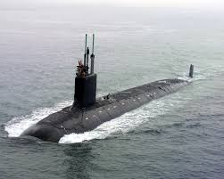

Second Law of Thermodynamics
Thermal Energy Reservoir (Heat Reservoir)
Atmosphere
Ocean
Rivers
Examples of Sink

Slide 6
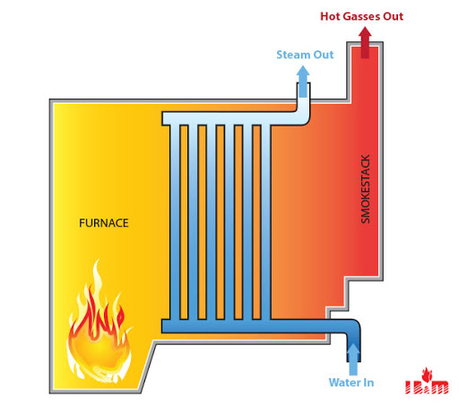
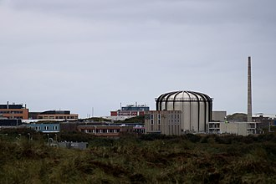
Second Law of Thermodynamics
Thermal Energy Reservoir (Heat Reservoir)
Boiler furnace
Nuclear reactor
Sun
Examples of Sources

Slide 7
Second Law of Thermodynamics
Heat Engine
It is a closed system which operates in a cycle and produces a net quantity of work from a supply of heat.
NATURE
WORK
HEAT
directly and completely (100%)
NEED A HEAT ENGINE
HEAT
WORK
(No 100% conversion)
NO 100 % CONVERSION OF HEAT TO WORK
(NO 100 % THERMAL EFFICIENCY)

Slide 8
Second Law of Thermodynamics
Heat Engine:
4 Conditions for the working fluid
It receives heat from a high-temperature source (solar energy, oil furnace, nuclear reactor, etc.)
It converts part of this heat into work (usually in the form of a rotating shaft)
It rejects the remaining heat into a low-temperature sink (the atmosphere, rivers, etc.)
It goes through a thermodynamic cycle.
High Temperature source
Q_{in}
400 MW
Heat Engine
160 MW
W_{out}
240 MW
Q_{out}
Low Temperature sink

Slide 9


Second Law of Thermodynamics
Heat Engine:
Some examples of heat engines are;
Steam power plants
Gas power plants
Automobile engines
Qin
400 MW
Boiler
165 MW
5 MW
Turbine
Turbine
Wout
Pump
Win
Condenser
Qout
240 MW

Slide 10
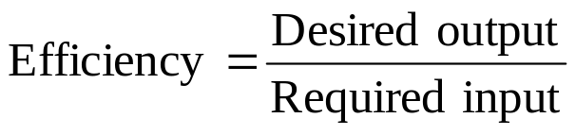
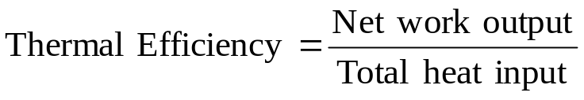
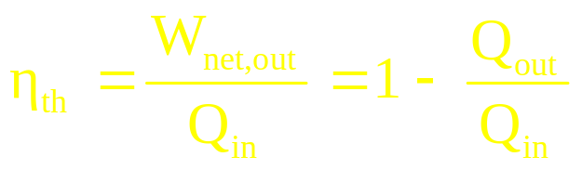

Second Law of Thermodynamics
Thermal Efficiency of a Heat Engine:
Qin
400 MW
Boiler
165 MW
Turbine
5 MW
Turbine
Wout
Pump
$\text{η}\text{th}\text{=}\frac{\text{W}\text{net}}{\text{Q}\text{in}}$ = $\frac{\text{160}}{\text{400}}$ = 40%
Win
Condenser
Qout
240 MW

Slide 11
Second Law of Thermodynamics
Kelvin-Planck statement of the Second Law:
It is impossible for any device that operates on a cycle to receive heat from a reservoir and do an equivalent amount of work on the surroundings.
There is no heat engine with 100 % thermal efficiency.
High Temperature source
Q_{in}
400 MW
Heat Engine
400 MW
W_{net out}
Impossible (PMM 2nd kind)

Slide 12


Second Law of Thermodynamics
Heat Engine: Example 1
Heat is transferred to a heat engine from a furnace at a rate of 80 MW. If the rate of waste heat rejection to a nearby river is 50 MW, determine the net power output and the thermal efficiency for this heat engine.
$\text{W}\text{net}$ = Q_{net} = 80 MW – 50 MW = 30 MW
$\text{η}\text{th}\text{=}\frac{\text{W}\text{net}}{\text{Q}\text{in}}$ = $\frac{\text{30}}{\text{80}}$ = 37.5%

Slide 13
Second Law of Thermodynamics
Heat Engine: Example 2
A steam power plant is constructed such that it produces 75 kW of power while rejecting 190 kW of heat to a low-temperature reservoir.
Determine the rate of heat supplied
Determine the thermal efficiency.
Suggested Answers:
[ 265 kW; 28.3%]
Heat Engine: Example 3
An engine receives heat at the rate of 2000 kJ/min and produces 10 kW of power at the output shaft. Determine the efficiency and the heat rejected per minute.
Suggested Answers:
[ 30%; 1400 kJ/min]

Slide 14
Second Law of Thermodynamics
Reversed Heat Engine:
It is a closed system which operates in a cycle such that it extracts heat from a low-temperature reservoir and rejects heat to a high temperature reservoir while a net quantity of work is done on the system by the surroundings.
Refrigerators and Heat pumps are examples of reversed heat engines.
High Temperature source T_{H}
_{Impossible}
Low Temperature sink T_{L}

Slide 15
Second Law of Thermodynamics
Reversed Heat Engine:
If the desired effect is the heat extracted from the low temperature sink (Q_{L}), the system is referred to as a refrigerator.
If the desired effect is the heat rejected to the high temperature source (Q_{H}), the system is referred to as a heat pump.
High Temperature source T_{H}
Q_{H}
Q_{H}
Q_{H}
RHE
W_{in}
Condition
Q_{L}
Q_{L}
Q_{L}
Low Temperature sink T_{L}

Slide 16
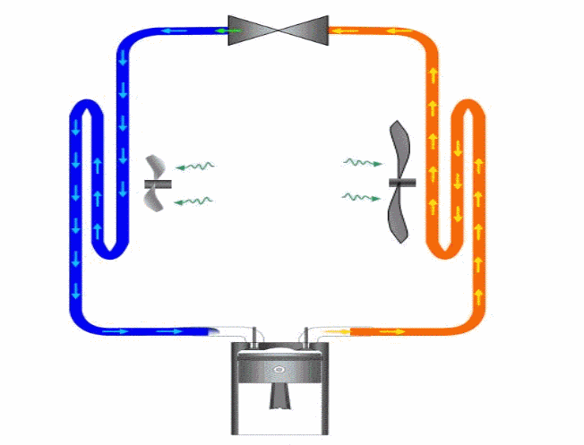
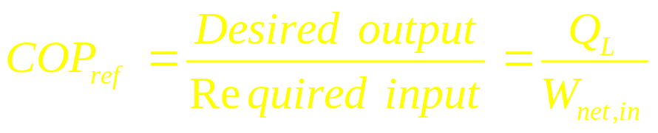

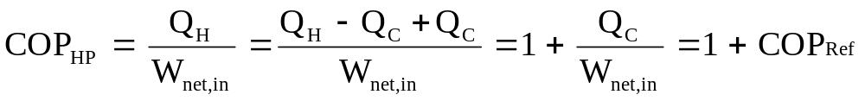
Second Law of Thermodynamics
Performance of Refrigerators and Heat pumps
Coefficient of performance
Expansion device
Condenser
Evaporator
Compressor

Slide 17
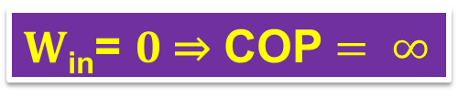
Second Law of Thermodynamics
Clausius statement of the Second Law:
It is impossible to construct a system that operates in a cycle and transfer heat from a cooler to a hotter body without work being done on the system by the surroundings.
Environment at T_{H}
Q_{H}
  25 kW
Refrig
  W_{in} = 0 kW
Q_{L}
  25 kW
$W$_{in}= $0$⇒ COP $= ∞$
Area to cool at T_{L}

Slide 18
Second Law of Thermodynamics
Reversed Heat Engine: Example 1
The food compartment of a refrigerator is removing heat at a rate of 360 kJ/min. if the required power input to the refrigerator is 2 kW, determine the COP of the refrigerator and the rate of heat rejection to the room that houses the refrigerator. What would be the COP of a corresponding heat pump?
Suggested Answers: [ 3; 8 kW; 4]
Reversed Heat Engine: Example 2
A household refrigerator with a COP of 1.8 removes heat from the refrigerated space at a rate of 90 kJ/min. Determine
a) the electric power consumed by the refrigerator in kW and
b) the rate of heat transfer to the kitchen air in kJ/min
Suggested Answers: [ 0.83 kW; 140 kJ/min]

Slide 19
Second Law of Thermodynamics
Reversed Heat Engine: Example 3
An air conditioner removes heat steadily from a house at a rate of 750 kJ/min while drawing electric power at a rate of 5 kW. Determine
a) the COP of this air conditioner and
b) the rate of heat transfer to the outside air in kJ/min.
Suggested Answers: [ 2.5; 1050 kJ/min]
Reversed Heat Engine: Example 4
Determine the COP of a heat pump that supplies energy to a house at a rate of 8000 kJ/h for each kW of electric power it draws. Also determine the rate of energy absorption from the outside air in kJ/h.
Suggested Answers: [ 2.22; 4400 kJ/h]

Slide 20
Second Law of Thermodynamics
Note:
Every system operating in a cycle must satisfy both the first law and second law
Qin
400 MW
Boiler
405 MW
Turbine
5 MW
Turbine
Satisfies First Law
Violates Second Law
Wout
Pump
Win
Condenser
Qout
0 MW

Slide 21
Second Law of Thermodynamics
Qin
400 MW
Note:
Every system operating in a cycle must satisfy both the first law and second law
Boiler
165 MW
Turbine
5 MW
Turbine
Wout
Pump
Satisfies Second Law
Violates First Law
Win
Condenser
Qout
200 MW

Slide 22
Second Law of Thermodynamics
Note:
Every system operating in a cycle must satisfy both the first law and second law
Qin
400 MW
Boiler
165 MW
Satisfies First Law
Turbine
5 MW
Turbine
Wout
Pump
Win
Satisfies Second Law
Condenser
Qout
240 MW

Slide 23
Second Law of Thermodynamics
Reversibility
A process undergoes a change in a particular direction.
If the process can be reversed in such a manner that the path can be exactly traced to restore the system and its surroundings to their original state, then the process is said to be reversible.
A reversible process is an idealization of actual processes.
They are easy to analyze and serve as a yardstick which actual processes can be compared to.
Conditions for reversibility
The process may proceed in either direction.
That the system is always in a state of equilibrium.
Heat energy transfer process is isothermal.
That friction is absent.
The energy transformations in both directions must be equal.
That the system and its surroundings can be restored to its original condition by retracing in the reverse direction every point it took in the original direction.

Slide 24
Second Law of Thermodynamics
Irreversibility
If the process cannot be reversed in such a manner that the path can be exactly traced to restore the system and its surroundings to their original state, then the process is said to be irreversible.
Actual processes encounter some irreversibilities.
Conditions for irreversibility
The presence of friction
Heat energy transfer from a higher to a lower temperature.
Unrestricted expansion (or free expansion) from a higher to a lower pressure.
Paddle or stirring wheel work
Lack of pressure equilibrium throughout the system.
Presence of electrical resistance.

Slide 25
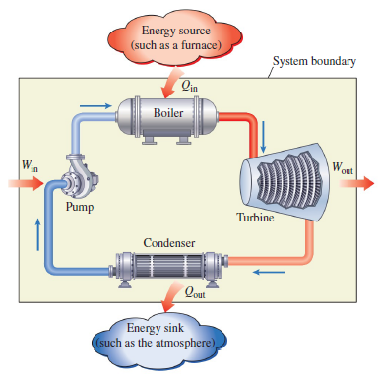
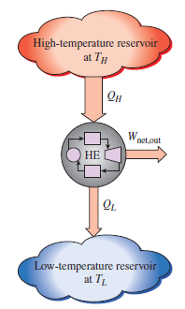
Second Law of Thermodynamics
Heat Engine Cycle
Steam power plant

Slide 26
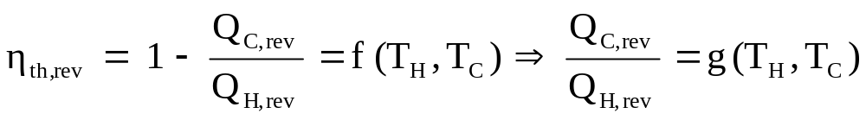
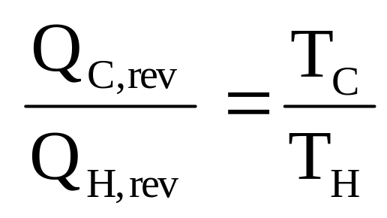
Second Law of Thermodynamics
Carnot Principle
Sadi Carnot proposed a heat engine cycle composed of reversible processes which gave maximum possible net work output when operating between two fixed temperature limits, T_{C} and T_{H}.
By definition, the only significant property of a heat reservoir is its temperature, not its substance.
Between the same two reservoirs, the efficiency of a reversible heat engine is always greater than the efficiency of an irreversible one.

Slide 27
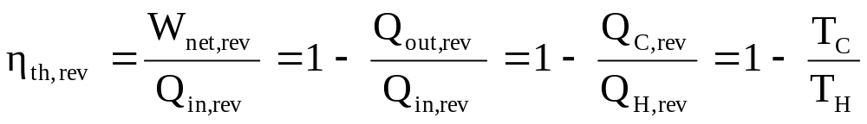
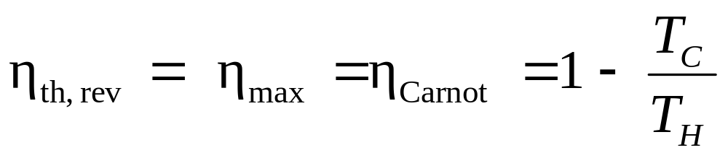
Second Law of Thermodynamics
Carnot Efficiency
Carnot efficiency is the theoretical maximum efficiency that only a reversible heat engine (HE) operating between the temperature limits, T_{H} and T_{C} can achieve.
Example: What is the Carnot efficiency of a Heat engine operating between a heat source of 1000 K and a heat sink of 300 K?

Slide 28



Second Law of Thermodynamics
SOURCE @ T_{H} = 1000 K
ReversibleHE
$η$_{th} = 70%
IrreversibleHE
$η$_{th}< 70%
ImpossibleHE
$η$_{th} > 70%
SINK @ T_{C} = 300 K

Slide 29
Second Law of Thermodynamics
Heat Engine on Carnot Principle: Example 1
A power cycle operating between two reservoirs receives energy Q_{H} by heat transfer from a hot reservoir at T_{H} = 2000K and rejects energy Q_{C} by heat transfer to a cold reservoir at T_{C} = 400K. For each of the following cases, determine whether the cycle operates reversibly, irreversibly, or is impossible.
Q_{H} = 1000 kJ, W_{net} = 850 kJ b) Q_{H} = 2000 kJ, Q_{C} = 400 kJ
c) W_{net} = 1600 kJ, Q_{C} = 500 kJ d) Q_{H} = 1000 kJ, η = 30%
Suggested answers [(a) impossible; (b) reversible; (c) irreversible; (d) irreversible

Slide 30
Second Law of Thermodynamics
Carnot Heat Engine: Example 2
A Carnot heat engine receives 500 kJ of heat from a source of unknown temperature and rejects 200 kJ of it to a sink at 17 °C. Determine
a) the temperature of the source and
b) the thermal efficiency of the heat engine.
Suggested Answers: [452 °C; 60%]
Carnot Heat Engine: Example 3
An engine operates on the Carnot cycle. The engine efficiency is 60 percent when 20 kJ/kg per engine cycle of thermal energy is rejected to a low-temperature reservoir at T_{C} = 27 °C, and has a specific net work output of magnitude 30 kJ/kg per cycle.
(a) How much energy is transferred to the engine from the high-temperature reservoir per cycle (kJ/kg)?
(b) At what temperature T_{H} is the high-temperature reservoir?
Suggested Answers: [50 kJ/kg; 477 °C]

Slide 31
Second Law of Thermodynamics
Reversed Heat Engine on Carnot Principle: Example 1
A refrigeration cycle operating between two reservoirs receives energy Q_{C} from a cold reservoir at T_{C} = 250 K and rejects energy Q_{H} to a hot reservoir at T_{H} = 300 K. For each of the following cases, determine whether the cycle operates reversibly, irreversibly, or is impossible.
Q_{C} = 1000 kJ, W_{in} = 400 kJ b) Q_{C} = 2000 kJ, W_{in} = 2200 kJ
c) W_{in} = 500 kJ, Q_{H} = 3000 kJ d) W_{in} = 1000 kJ, COP_{R} = 6
Suggested answers [(a) irreversible; (b) irreversible; (c) reversible; (d) impossible

Slide 32
Second Law of Thermodynamics
Reversed Carnot Heat Engine: Example 2
A Carnot heat pump delivers a heat transfer of 3 x 10⁴ kJ at 50 °C. The evaporator is at 15 °C. Calculate the power input and the coefficient of performance for this Carnot heat pump.
Suggested Answers: [3.25 x 10³ J; 9.229]
Reversed Carnot Heat Engine: Example 3
A Carnot refrigerator rejects a heat transfer of 2.5 x 10³ kJ at 80 °C. If the power input for this refrigerator is 1.1 x 10³ kJ, find the heat transferred, the low temperature in the cycle, and the coefficient of performance.
Suggested Answers: [1.4 x 10³ kJ; -75.3 °C; 1.27 ]

Slide 33
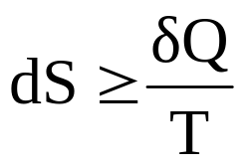
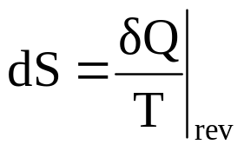
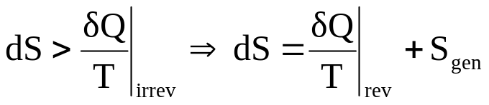
Second Law of Thermodynamics
Entropy
Entropy is a quantitative measure of the disorderliness or randomness of a system.
It is a measure of energy that is no longer available to perform useful work within the current environment.
Second Law: There exist a property of a closed system such that a change in its value is greater than or equal to the heat transfer to the system over some constant temperature.
This property is called Entropy (S).
This law is expressed mathematically as;
For a reversible process
For an irreversible process
S_{gen} is the entropy generation within the system itself as a result of friction and other irreversibilities present within the system.

Slide 34
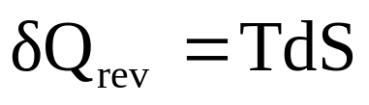
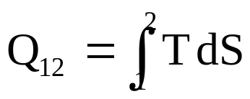
Second Law of Thermodynamics
Entropy
For a reversible adiabatic process, the entropy of the system during the process remains constant. Thus, the entropy change of the system during the process is zero (dS = 0).
The entropy change of an isolated system during a process always increases or in the limiting case of a reversible process remains constant.
T
1
T
1
2
Q₁₂ = 0
Q₁₂
2
S
S
Constant entropy process (isentropic process)
Constant temperature process (isothermal process)

Slide 35
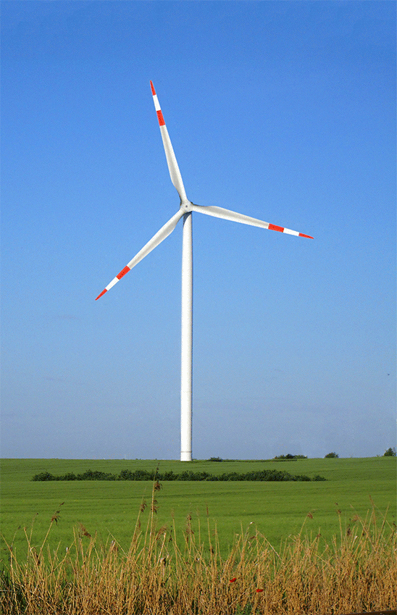
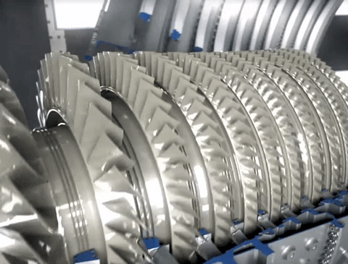
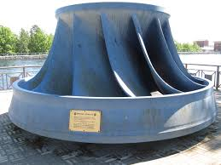
Second Law of Thermodynamics
Entropy
∆S is a measure of the level of irreversibilities in the system.
Isentropic efficiency: a comparison of performance between ideal and actual work producing devices.
Energy
Fluid
Blades
Turbines

Slide 36
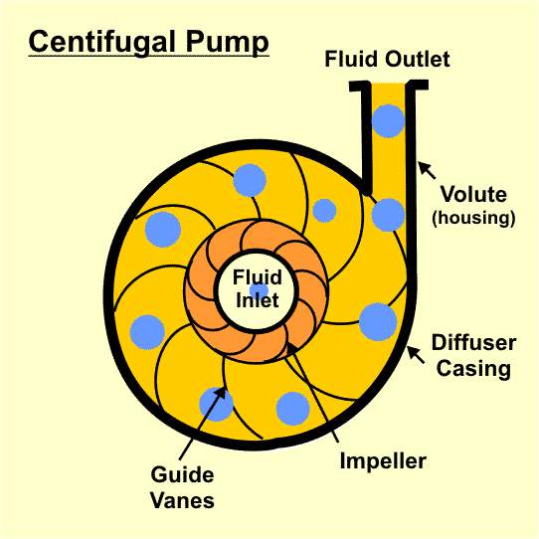
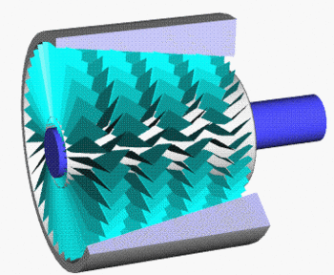
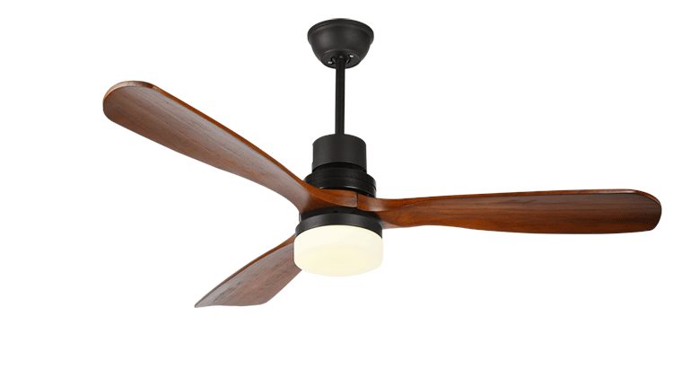
Second Law of Thermodynamics
Entropy
∆S is a measure of the level of irreversibilities in the system.
Isentropic efficiency: a comparison of performance between ideal and actual work consuming devices.
Energy
Pumps
Compressors
Fans
Fluid
Blades

Slide 37




Second Law of Thermodynamics
Entropy
∆S is a measure of the level of irreversibilities in the system.
Isentropic efficiency: a comparison of performance between ideal and actual work producing or consuming devices.
Example: $ηisen$ = 90% and W_{isen} = 250 MW
Example: $ηisen$ = 95% and W_{isen} = 100 MW
W_{actual} = 250 x 0.9 = 225 MW
W_{actual} = 100 / 0.95 = 105 MW

Slide 38
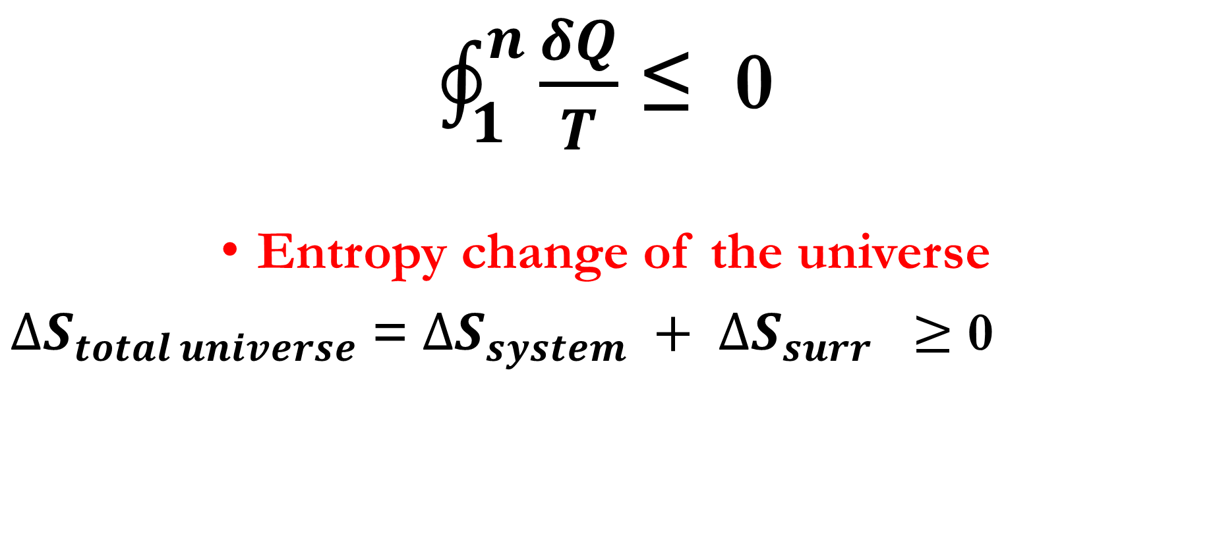
CLAUSSIUS INEQUALITY
$\oint_{1}^{n}{\frac{δQ}{T}}$ ≤ 0
Entropy change of the universe
$∆S_{total universe}$ = ${ΔS}_{system} + ΔS_{surr} ≥$ 0

Slide 39
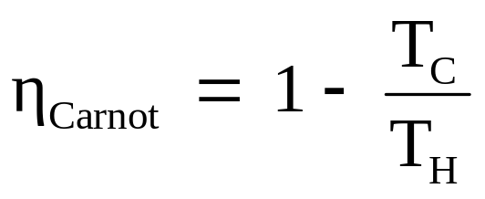
Second Law of Thermodynamics
Carnot Cycle: Four processes
Two isothermal (constant temperature) heat transfer processes
Two reversible adiabatic (constant entropy) work transfer processes
T
T_{H}
1
2
Q_{net} = W_{net}
T_{C}
4
3
S

Slide 40
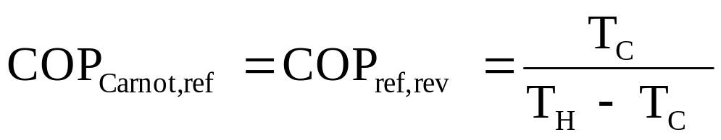
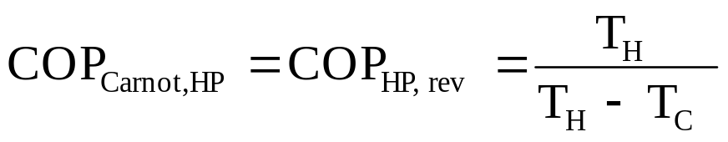
Second Law of Thermodynamics
Reversed Carnot Cycle: Being a reversible cycle, all the processes that comprise the Carnot cycle can be reversed, in which case it becomes the Carnot refrigeration cycle or Carnot heat pump cycle.
T
T_{H}
4
3
Q_{net} = W_{net}
T_{C}
1
2
S

Slide 41
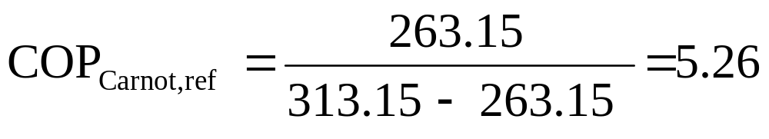
Second Law of Thermodynamics
Example:
A fridge working on the reversed Carnot cycle has a power requirement of 5 kW. If the maximum and minimum temperatures in the cycle are 40 °C and -10 °C respectively, determine:
(a) The COP
(b) The rate of heat extraction from the cold space
(c) The change in specific entropy for each of the processes in the cycle, given a refrigerant mass flow rate of 0.32 kg/s
Solution:
T
T_{H}
4
3
Q_{net} = W_{net}
T_{C}
1
2
S

Slide 42
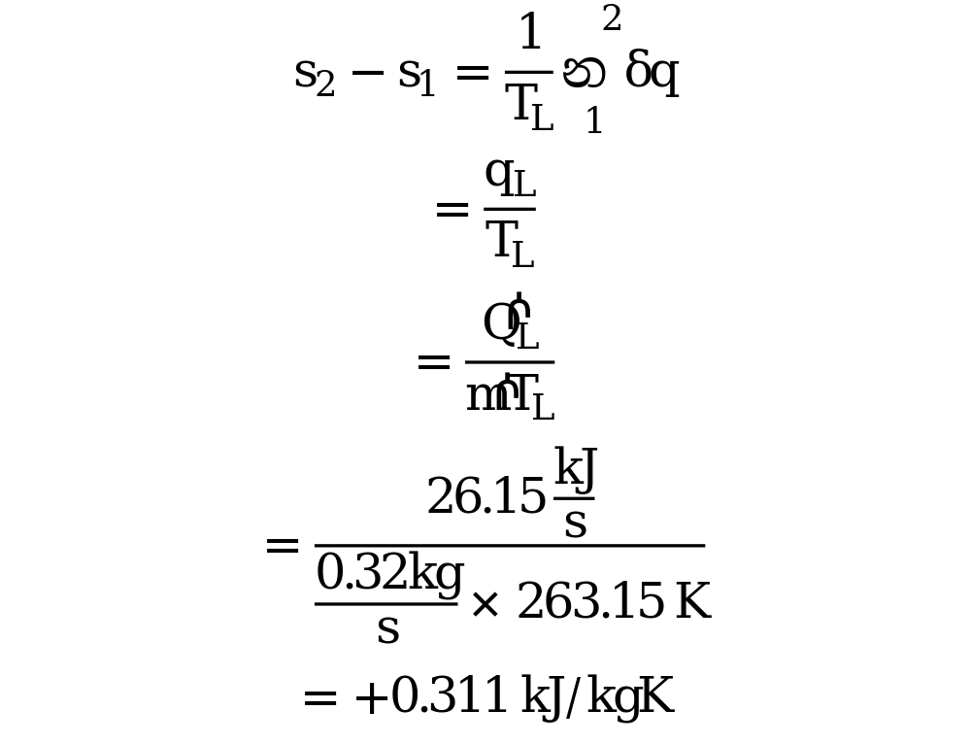
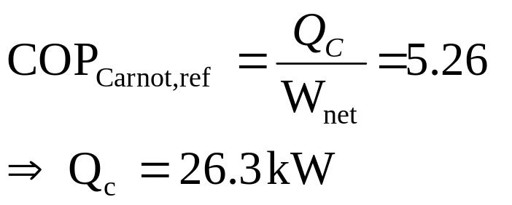
Second Law of Thermodynamics
Solution
T
T_{H}
4
3
Q_{net} = W_{net}
T_{C}
1
2
S

Slide 43
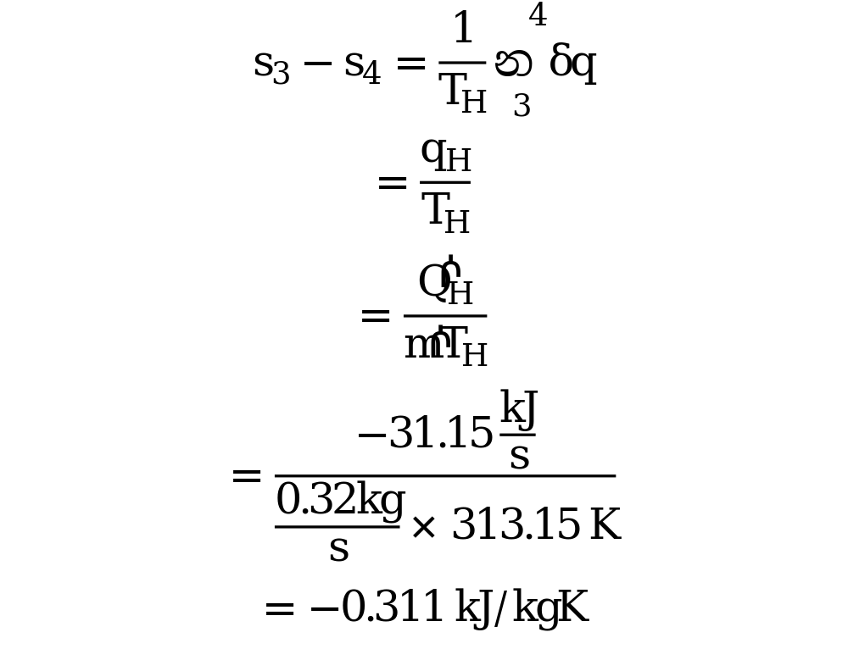
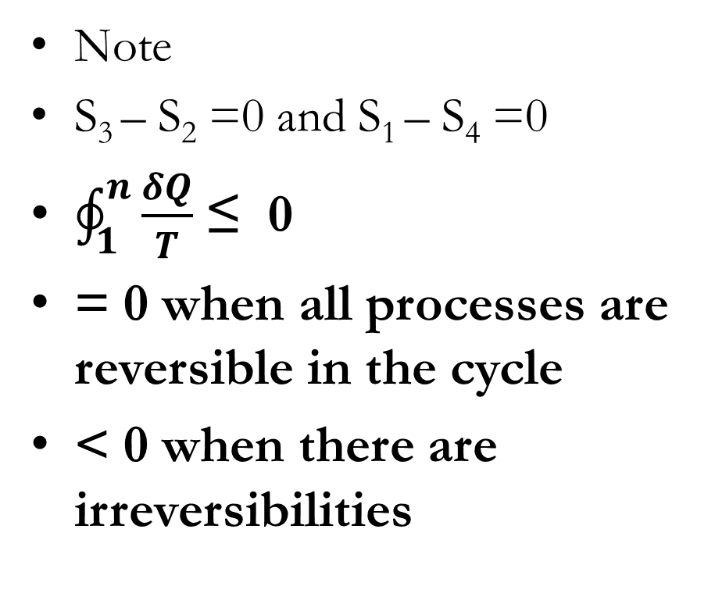
Second Law of Thermodynamics
Note
S₃ – S₂ =0 and S₁ – S₄ =0
$\oint_{1}^{n}{\frac{δQ}{T}}$ ≤ 0
= 0 when all processes are reversible in the cycle
< 0 when there are irreversibilities

Slide 44
Second Law of Thermodynamics
Example 2
A system of 100 kg mass undergoes a process in which the specific entropy increases from 0.3 kJ/(kg.K) to 0.4 kJ/(kg. K). At the same time, the entropy of the surroundings of the system decreases from 80 kJ/K to 75 kJ/K. This process is:
(a) reversible (b) irreversible (c)reversible and adiabatic (d) impossible

Slide 45
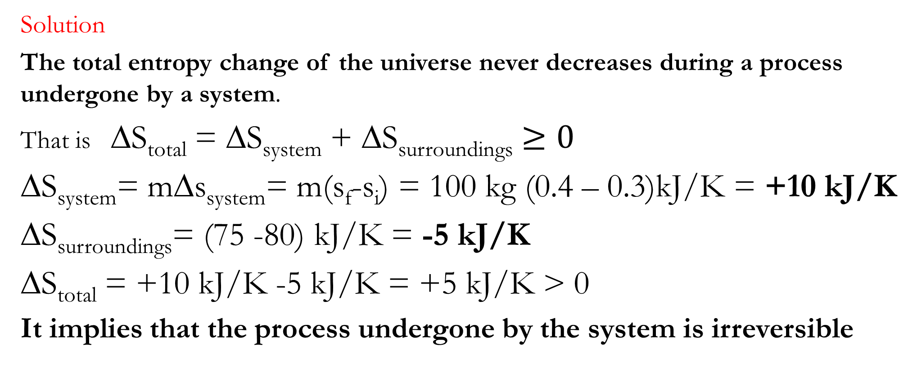
Second Law of Thermodynamics
Solution
The total entropy change of the universe never decreases during a process undergone by a system.
That is ∆S_{total} = ∆S_{system} + ∆S_{surroundings} $≥0$
∆S_{system}= m∆s_{system}= m(s_{f}-s_{i}) = 100 kg (0.4 – 0.3)kJ/K = +10 kJ/K
∆S_{surroundings}= (75 -80) kJ/K = -5 kJ/K
∆S_{total} = +10 kJ/K -5 kJ/K = +5 kJ/K > 0
It implies that the process undergone by the system is irreversible

Slide 46

KNUST-SESC

